Slide 1
<your name>
<your picture>
<your title>
@<your handle> on Twitter
Notes:
Hello. I’m []
//share a bit about yourself, why you love technology

Slide 2

Microsoft mission
Empower every person and every organization on the planet to achieve more

Slide 3








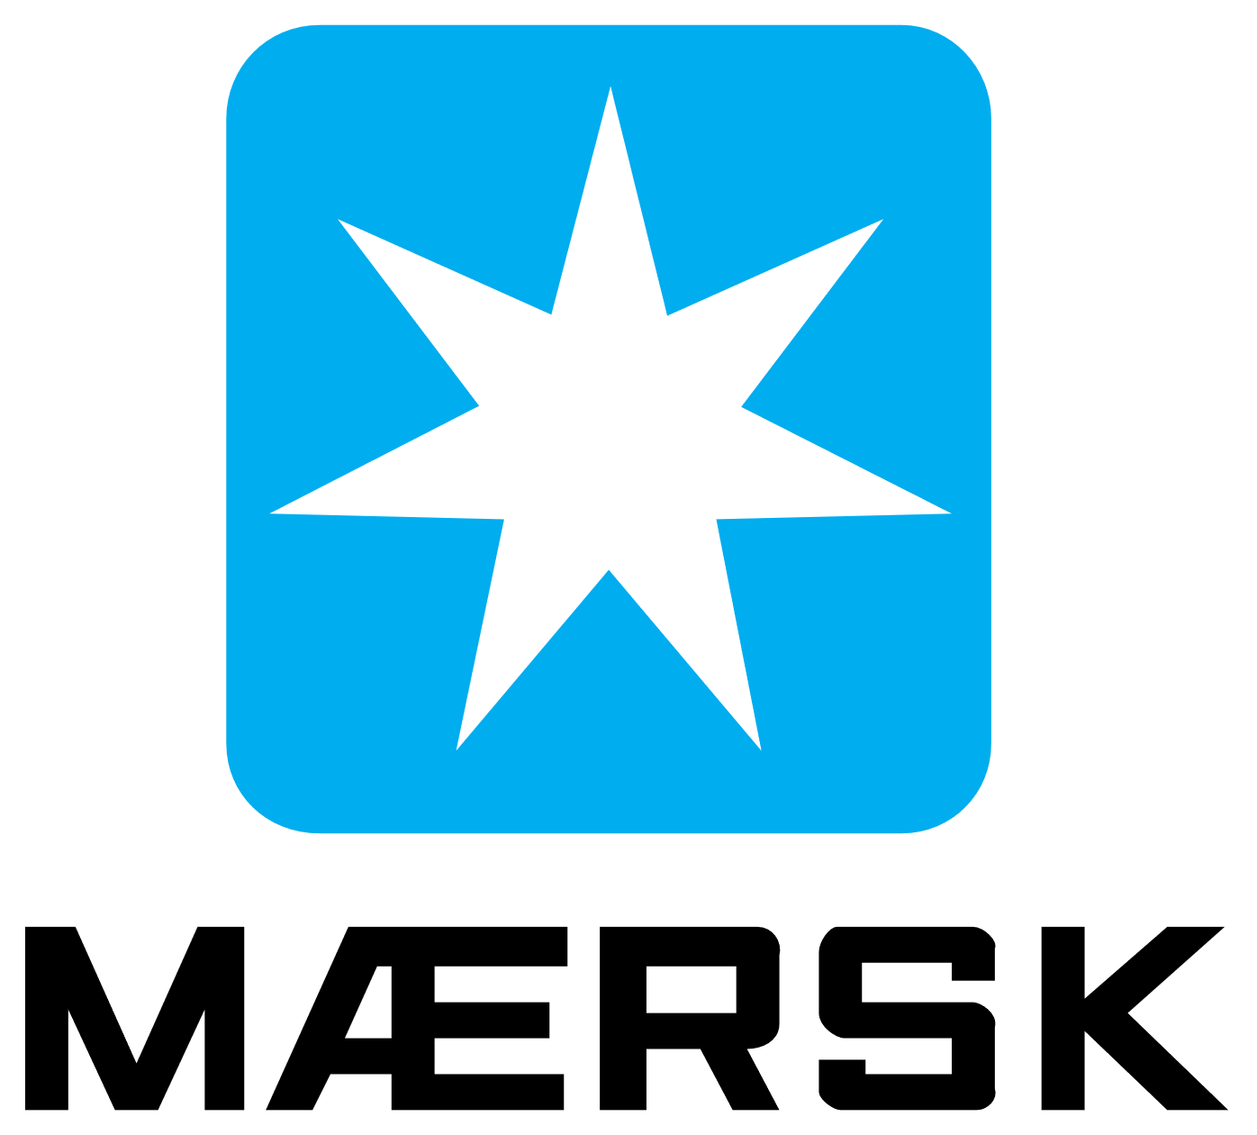
















90%
of the Fortune 500 use Azure⁵
Notes:
[SLIDE GOAL: Learning Azure can help you get a job, 90% of Fortune 500 use Azure]
Azure is a smart choice for your career. Some of you might choose to work for large companies, and chances are high that your company will use the cloud.
90% of the Fortune 500 use Azure.
[Quick point, no need to linger.]
⁵ Microsoft. “Confidence in the trusted cloud.” https://azure.microsoft.com/en-us/overview/trusted-cloud/.

Slide 4
42
Azure regions⁶
Notes:
[SLIDE GOAL: Microsoft has more data centers around the world than any other cloud provider]
[Quick point, no need to linger—shorten narrative above if desired.]
Some of the biggest apps in the world today, like Facebook and Twitter, started out as student projects. You want to know that, if and when your app takes off, you will be able to scale quickly around the world, with the performance and reliability of a vast global infrastructure.
Azure is generally available in 36 regions and 100 secure facilities around the world, with plans announced for 6 additional regions. That’s more than any other cloud provider. We place a high priority on geographic expansion to enable higher performance and to support your requirements and preferences regarding data location.
Microsoft is also building out availability zones to provide fault-tolerance in case of a natural disaster, so your apps are always secure.
⁶ Microsoft. “Introducing Azure Availability Zones for resiliency and high availability.” September 2017. https://azure.microsoft.com/en-us/blog/introducing-azure-availability-zones-for-resiliency-and-high-availability/.

Slide 5
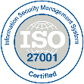
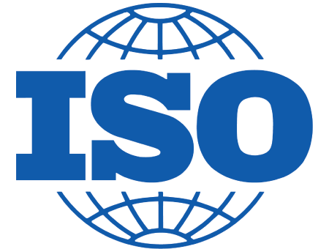



































Azure: The trusted cloud
GLOBAL
ISO 27001
ISO 27018
ISO 27017
ISO 22301
SOC 1 Type 2
SOC 2 Type 2
SOC 3
CSA STAR
Self-Assessment
CSA STAR
Certification
CSA STAR
Attestation
US GOV
Moderate
JAB P-ATO
High
JAB P-ATO
DoD DISA
SRG Level 2
DoD DISA
SRG Level 4
DoD DISA
SRG Level 5
SP 800-171
FIPS 140-2
Section 508 VPAT
ITAR
CJIS
IRS 1075
INDUSTRY
PCI DSS
Level 1
CDSA
MPAA
FACT UK
Shared
Assessments
FISC Japan
HIPAA/ HITECH Act
HITRUST
GxP
21 CFR Part 11
MARS-E
IG Toolkit UK
FERPA
GLBA
FFIEC
REGIONAL
Argentina PDPA
EU
Model Clauses
UK
G-Cloud
China
DJCP
China
GB 18030
China
TRUCS
Singapore
MTCS
Australia
IRAP/CCSL
New Zealand
GCIO
Japan My
Number Act
ENISA
IAF
Japan CS Mark Gold
Spain
ENS
Spain
DPA
India
MeitY
Canada
Privacy Laws
Privacy
Shield
Germany IT
Grundschutz
workbook
Notes:
[SLIDE GOAL: Azure has more security certifications than any other cloud provider, you can trust Azure to protect your code and data.]
[Spend a little more time on this slide than the last two; generation Z research suggests today’s students care about privacy and security]
As students, the first app you build probably won’t include a bunch of features about security and privacy. That’s something you really start to care about as your user base grows.
But when it does, you’ll want the kind of security that today’s and tomorrow’s customers demand. Or if you work for a company or large organization, chances are they will want your apps to be resistant to cyber-espionage or other attacks.
Azure has more security certifications than any other cloud provider, and it meets a broad set of international and industry-specific compliance standards. Because Azure powers large, complex organizations with huge customer bases, this is not something we take lightly. It’s in our culture and what makes Azure different. We build a cloud that gives ownership of, and control over, the collection, use, and distribution of all types of information, and we think the organizations Azure powers and their customers will certainly appreciate that.
[No need to rattle these off for students, but for reference, they are ISO 27001, HIPAA, FedRAMP, SOC 1, and SOC 2, in addition to country-specific standards like Australia IRAP, UK G-Cloud, and Singapore MTCS. Rigorous third-party audits, such as by the British Standards Institute, verify the Azure platform’s adherence to the strict security controls these standards mandate.]

Slide 6
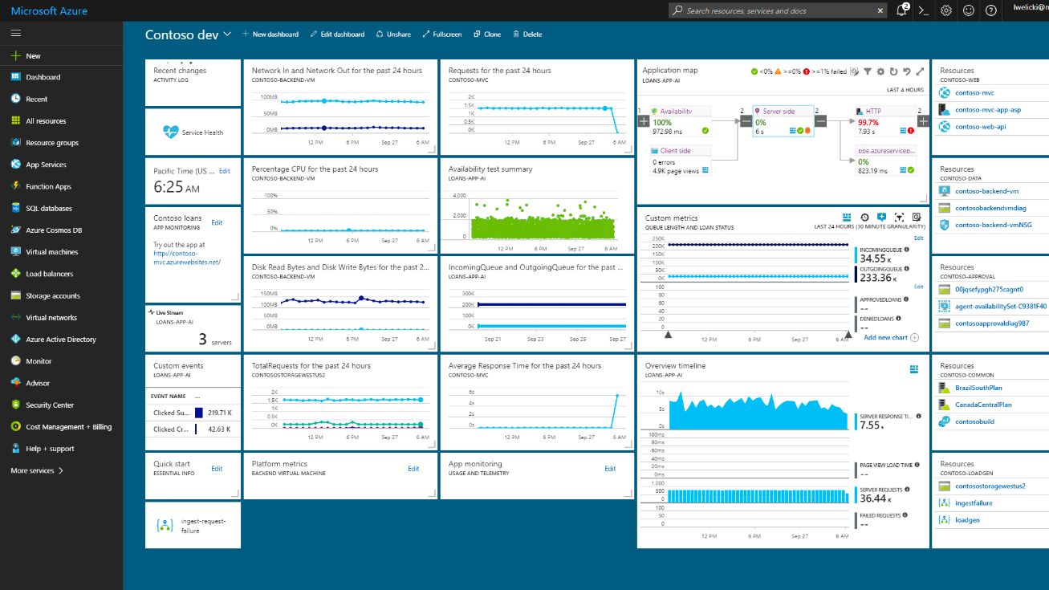
docs.microsoft.com/azure

Slide 7
Linux
Python
Java
node.js
Docker
Android
And many more …
With Azure, you have choices
40%
of Azure VMs run Linux⁴
Notes:
When you’re looking at cloud platforms, the first thing you want to make sure about—understandably—is whether you can build with your preferred tools and languages on your device. In other words, it needs to be an open platform.
So let’s make sure one thing is clear: Azure is open. You can run any stack, whether it’s Linux operating system (OS)–based or Windows OS–based. In fact, about one-third of Azure virtual machines (VMs) specifically run Linux. You can also use open-source tools like a Kubernetes cluster in Azure Container Service. And Azure supports Docker too, of course. And GitHub platform–based DevOps. And more.
[Ad-lib on your favorite technologies. Provide examples of the great variety of workloads that can run in Azure, landing the point that Azure is not even remotely limited to the Microsoft stack:
Web app in Java
Android app using Azure App Service
Xamarin app with C# targeting 3+ platforms
Data science Linux VM
Apps with TensorFlow and similar
The point is, you have choices. Choices that help you maximize your existing investments. Get support for infrastructure as a service (IaaS) on Linux, Java, and PHP or node.js application platforms. Develop and test your Linux and open-source components in Azure. You bring the tools you love and skills you already have, and you run virtually any application using your data source, with your operating system, on your device.
Provide cross-device experiences with support for all major mobile platforms.]
⁴ ZDNet. “Microsoft says 40 percent of all VMs now are running Linux.” October 2017. www.zdnet.com/article/microsoft-says-40-percent-of-all-vms-in-azure-now-are-running-linux/.

Slide 8
Notes:
//Slide to use if your internet connection fails. Otherwise go to http://portal.azure.com and demo tips and tricks shown on series of hidden slides.
DEMO
You’re going to get hands on with Azure shortly, so let’s take a little tour to help you get around
AZURE PORTAL
No matter what you want to do with Azure, you always start by logging into the portal.
THEMES
You might notice that your portal does not like mine that’s because I have chosen a different theme under Settings, I like the high contrast themes.
PORTAL NAVIGATION
At first glance it can the portal can be a little overwhelming, but it’s actually pretty simple once you learn the basics.
If you want to create anything, a VM, a web app, a cognitive service you name it, you can just click on the + symbol and you get a list of choices.
If you know exactly what you want to create. The search box is your friend!
Just type the service you want to create into the search box (type Virtual machine, text analytics)
Navigate to the page and choose +Add
DOCUMENTATION
Now in my experience there are two types of developers.
Those who want to follow a nice step by step tutorial, and those who just like to jump in and try to figure it out themselves.
Let’s say you just want to jump in and create a Linux VM
You would probably click + | Compute | Ubuntu server
Give your VM a name, enter a username and password
Notice there is pop-up help on some of the fields to give you a little help if needed
RESOURCE GROUPS
There’s on field here I want to point out, see that field marked resource group?
That is REALLY useful. Basically, a resource group is kind of like a folder you can use to keep related things together. Let’s say for your web site you need some BLOB Storage to store some images, a database and a web app, you can store them all together in one resource group. Then you can easily see everything that is used together for your web application by just going to the resource group, and if needed you can delete everything for that website by deleting the resource group.
Choose OK to continue
Pick a VM size – notice even a small VM can get pretty pricey pretty fast, VMs are always the most expensive services on all cloud platforms….
Which is why I love this option on the next screen
I am going to set “Auto-shutdown” it’s a great way to avoid accidentally leaving your VM running and using up all your credits
Choose create and off you go
THE DASHBOARD
You are brought back to the your Azure dashboard but you can check the notifications to see how your app is doing, and if you had clicked “pin to dashboard” you would have a tile for your website that allows you to easily get back to the website any time you need to.
Now for those of you who prefer step by step instructions…
DOCS.MICROSOFT.COM
If you are the kind of person who prefer step by step instructions to follow you would probably go to Bing and type “how to deploy a node website to Azure”. You will get back lots of blog posts, and videos with instructions, which is great, but unfortunately some of them may be out of date as the Azure portal does get regular update. So here’s a pro tip! Look for results at the URL docs.Microsoft.com! This is THE place to start for HOW TO documentation for Azure.
PORTAL COMMAND SHELL
Some tutorials will give you screenshots to follow, others will give you commands to execute. You can install the Azure CLI library in Bash or Powershell and run those commands locally, but I’m lazy, and I find it annoying to constantly install libraries on my computers. So I here’s another cool trick, there is a Command shell in the portal with the Azure CLI library already installed. So you can just copy the commands and run them here as PowerShell or Bash.
SEARCH
By now hopefully our VM is running so I can either navigate from notifications, click on the tile if I pinned it to my dashboard, or I can just search for the VM name “ubc”
I select the VM and click Connect and it returns the ssh command to connect t omy VM
So I run Bash on my laptop copy that command and voila I have connected to my Linux VM!

